Slide 1
Appendix E
Licensing
Introduction to CFX

Slide 2
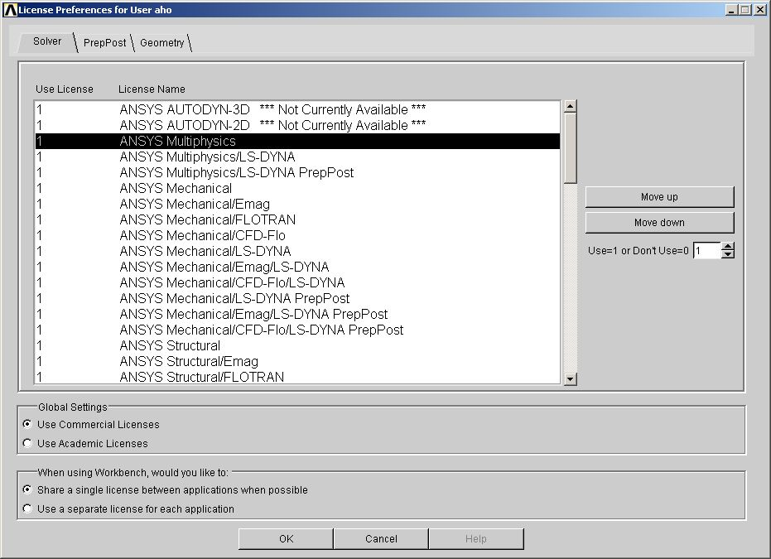
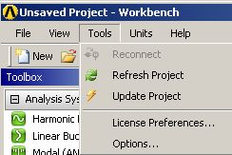
License Preferences
Workbench license control is handled through the user interface shown below, activated from the Workbench project page (“Tools > License Preferences . . . “).

Slide 3
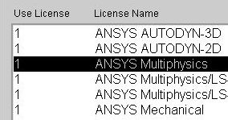
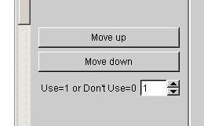
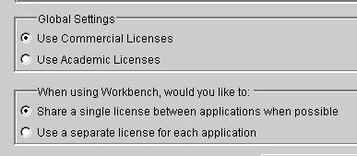
License Preferences
With the available licenses displayed, the activation and “use order” can be specified using the up/down arrows.
  0 = off, 1 = on
  License order represents the preference order for license use.
The license control allows Workbench users to specify whether a single license is used when multiple applications are open, or if all open applications access their own license.

Slide 4
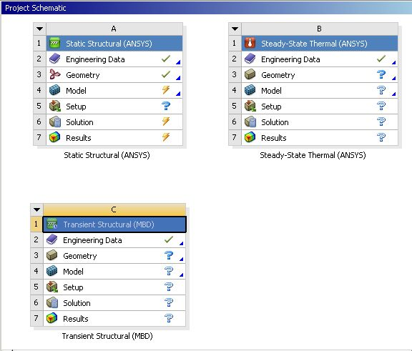
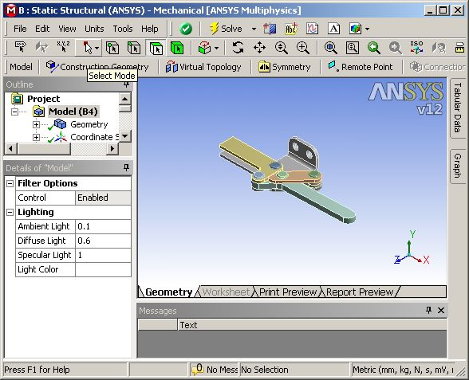
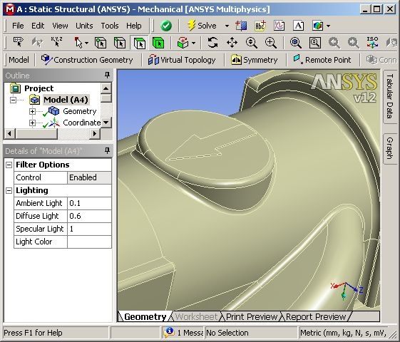
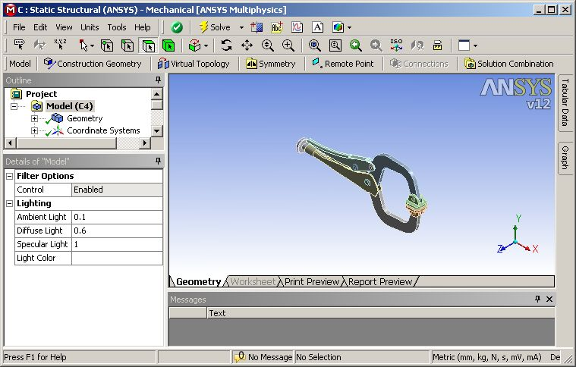
License Preferences
In the example shown, a user could have 3 Mechanical models open simultaneously. Using the license control they may choose to open 3 licenses or use only 1 that is shared. In the shared scenario, only the active Mechanical session uses the license (the remaining will be read only).

Slide 5
CFD Products
You may have purchased the following bundled products
  A bundled product provides access Meshing, a CFD Pre-processor, a CFD Solver and a Post-processor, running 1 task at a time
“ANSYS CFD”
  Run ANSYS Meshing, CFX-Pre, CFX-Solver, CFD-Post or FLUENT
“ANSYS CFX”
  Run ANSYS Meshing, CFX-Pre, CFX-Solver or CFD-Post
“ANSYS FLUENT”
  Run ANSYS Meshing, FLUENT or CFD-Post
“ANSYS CFD-Flo”
  A reduced capability version of CFX
    MFR, DES/SAS, Monte Carlo Radiation model, Inhomogeneous Multiphase and Combustion cannot be run
  Run ANSYS Meshing, CFX-Pre, CFX-Solver or CFD-Post

Slide 6
CFD Products
You may also have purchased the following modular products:
  Again, each product allows you to run only 1 task at a time
“ANSYS CFD Solver”
  Can run FLUENT, CFX-Pre or CFX-Solver
“ANSYS CFX Solver”
  Can run CFX-Pre or CFX-Solver
“ANSYS FLUENT Solver”
  Can run FLUENT
“ANSYS PrepPost”
  Can run ANSYS Meshing, CFX-Pre, CFD-Post or FLUENT Pre/Post-processing, but no solvers
“ANSYS CFD-Post”
  Can run CFD-Post
“ANSYS CFD HPC”
  Parallel licenses for use with either CFX or FLUENT

Slide 7
Some CFX Related Products
In addition to the core CFD products, the following are some of the related products available
“Design Modeler”
  None of the CFD products come with DM
“MCAD Connections”
  Connections to CAD systems, Parasolids and SAT files
  DM can import some files (IGES, STEP, Parasolids,…) without additional licenses, but this does not give a direct connection to a CAD system
“DesignXplorer”
  Optimization studies (basic parametric studies are built-in to Workbench)
“ANSYS ICEM CFD”
  Advanced meshing (Hex, Cartesian, …)
“Turbogrid”
  Automated high quality Hex meshing for turbomachinary applications
“BladeModeler”
  Automated geometry creating for blade designers
“Vista TF”
  Streamline curvature through-flow turbomachinary code

